Slide 1
UNIT TESTING
By -: Rakhi Agarwal

Slide 2
Why Unit Testing ?
Suppose we have a banking system, In bank website we have a form which takes input from user like amount, duration. After filling all details when user clicks on calculate EMI, An monthly EMI will be shown to user.
In backend, system will work like calling various code layers like UIL,BAL,DLL.
If anything failed, it is very hard to find culprit without debugging or it is hard to figure out the module which create bug.

Slide 3
Why Unit Testing ?
Here the cost of testing a single functionality is too much.
After every small change we have to test it through all layers and UI validation which is very tedious process.
Here Unit testing is coming as a savior.

Slide 4
What is Unit Testing ?
As name indicate “UNIT”, It test only unit piece of code.
By means of Unit testing, underlying dependences should not be tested.
Various Unit Testing frameworks are available :
MSTEST
NUNIT
XUNIT.NET

Slide 5
Refactoring
Suppose CalculateInterest() method have 100 lines of code. It is very hard is this method failed to identify culprit line.
For Unit testing or Best practice method should contains only code which do unit work.
In case of CalculateInterest() method we have to break down this method into small piece of code(methods).
By modularize the CalculateInterest(), code reusability improves.
It is very easy to unit test those small methods.

Slide 6
Stub
Stub is used to bypass underlying dependencies, so that only target method will test.
Stub is done by using mocking.
External dependencies should used by dependency injection so that it can be mock.
Stub can’t failed the unit test.

Slide 7
Mocking
Mocking also used to bypass underlying dependencies, so that only target method will test.
Mock is done by using mocking.
External dependencies should used by dependency injection so that it can be mock.
Mock can be failed the unit test.
On mock object verify methods are called to verify either the underlying methods are called or not.

Slide 8
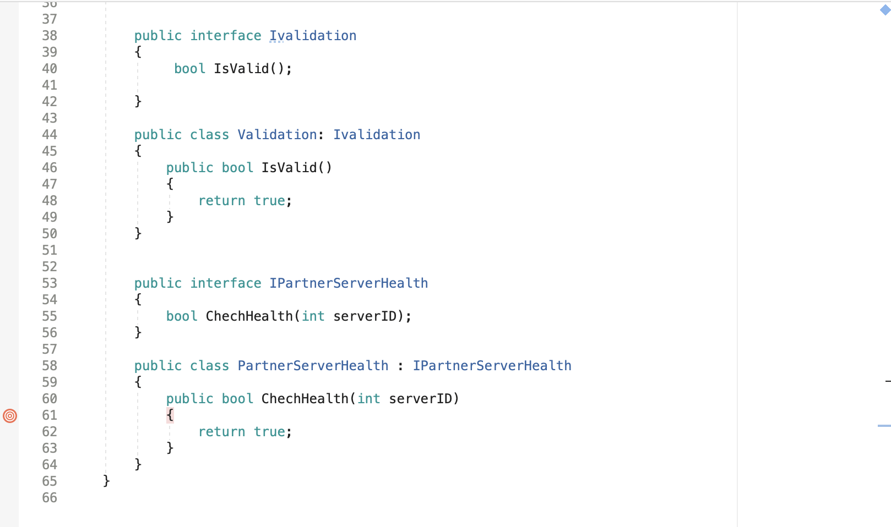
Code Snaps

Slide 9
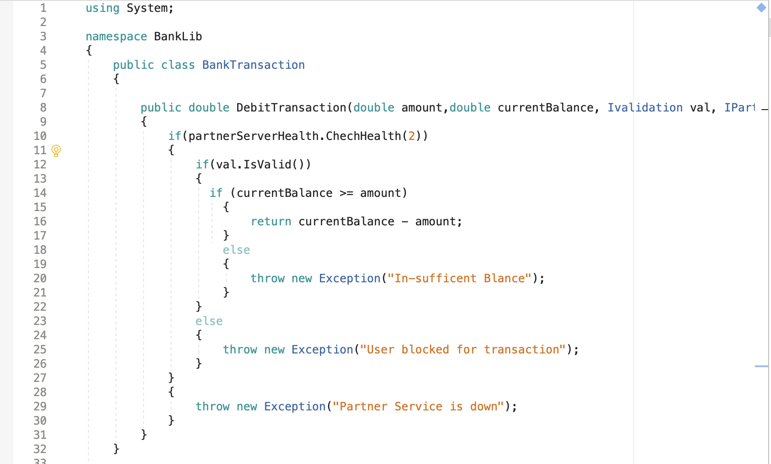
Code

Slide 10
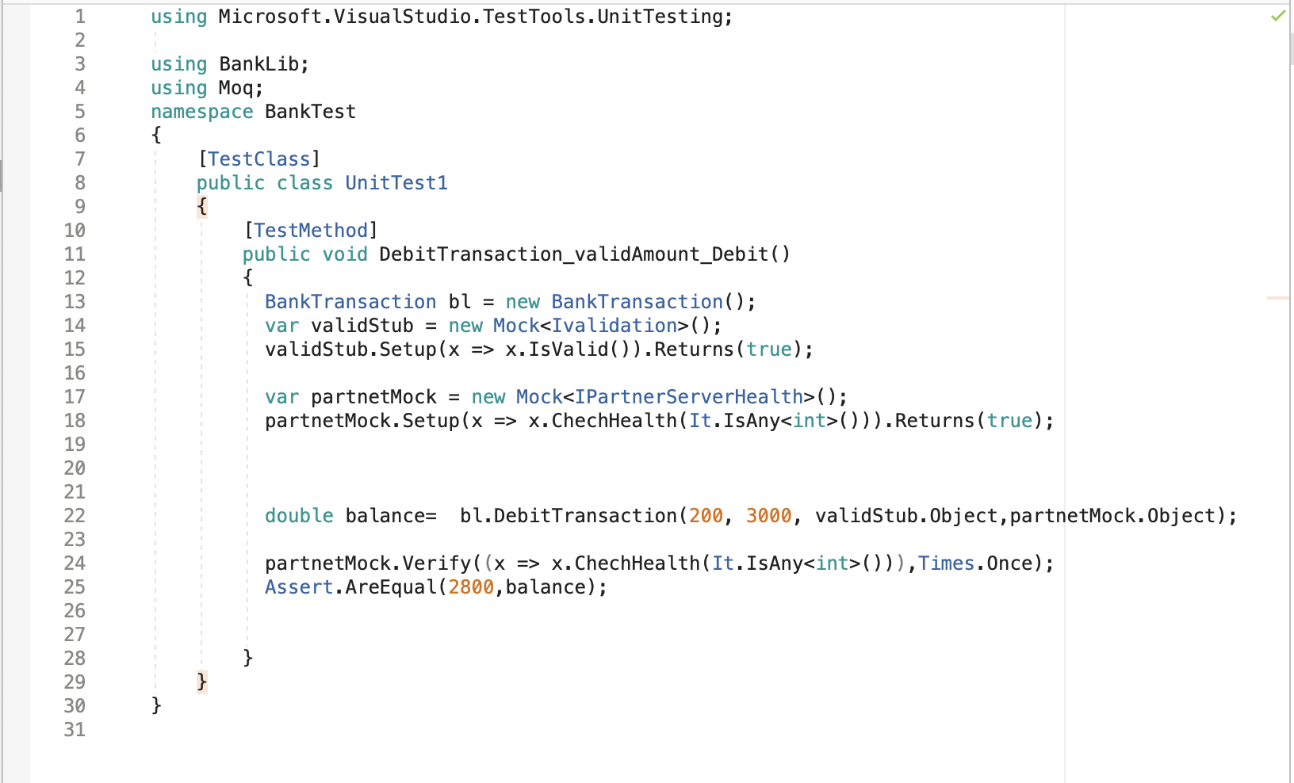
Code

Slide 11
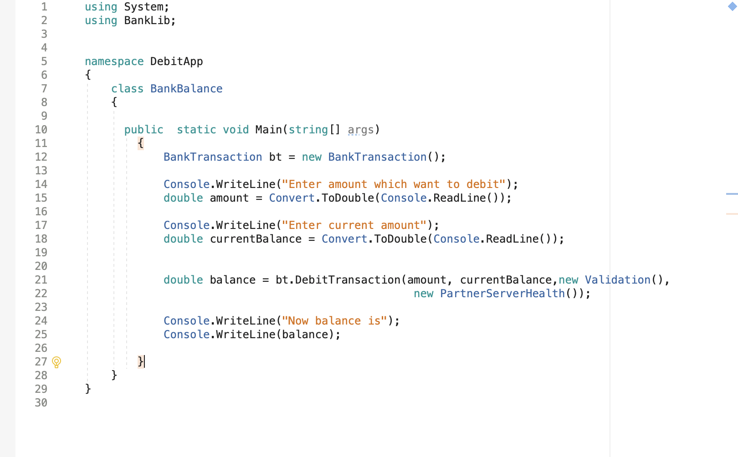
Code

Slide 12
[TestMethod]
ResolveQueries_AskMany_AllAnsweredCorrectly()
{
Mock<Queries> queries=new Mock<Queries>();
queries.Setup(x=>x. Queries()).Returns(true);
queries.Verify(x=>x. Queries(),Times.Never); }
Thanks

